Slide 1
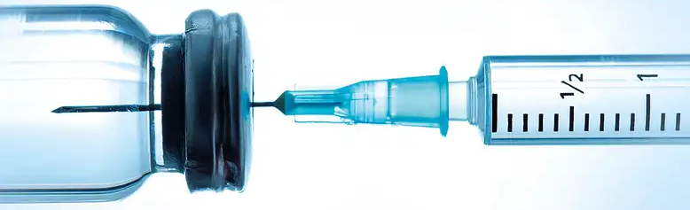
Update on Sexually Transmitted Infections
The Rhode Island Department of Health
March 21, 2022

Slide 2
The Public Health Impact of Sex Work
Objective #1: Review the public health impact of sex work.
Objective #2: Review the epidemiology of HIV and other sexually transmitted infections (STIs).
Objective #3: Discuss the potential impact of decriminalizing sex work from a public health perspective.
Rhode Island Department of Health

Slide 3
The Public Health Impact of Sex Work
Lack of Housing
Poverty
Mental Health
Sex Workers Face Many Disparities
Substance Use
Discrimination
Racism
Rhode Island Department of Health

Slide 4
The Public Health Impact of Sex Work
Repressive policies including criminalization of sex work has been associated with increased risk of…
Sexual/Physical
Violence
HIV/STIs
Condomless
Sex
Other
Increased risk of violence (Odds ratio 2.99);
Displacement of sex workers into unsafe situations.
Increased risk of HIV and other STIs (Odds ratio 1.87).
Increased risk condomless sex (Odds ratio 1.42);
Discourages sex workers carrying condoms.
Disruption of support networks and access to services;
Exacerbation of existing inequalities.
Rhode Island Department of Health
Platt et al., 2018

Slide 5
The Public Health Impact of Sex Work
There is a significant overlap between HIV/STIs and sex work.
Sexual/Physical
Violence
HIV/STIs
Condomless
Sex
Other
Increased of violence (Odds Ratio 2.99);
Displacement of sex workers into unsafe situations.
Increased risk of HIV and other STIs (Odds ratio 1.87).
Increased risk of condomless sex (Odds ratio 1.42);
Discourages sex workers carrying condoms.
Disruption of support networks and access to services;
Exacerbation of existing inequalities.
Rhode Island Department of Health
Platt et al., 2018

Slide 6
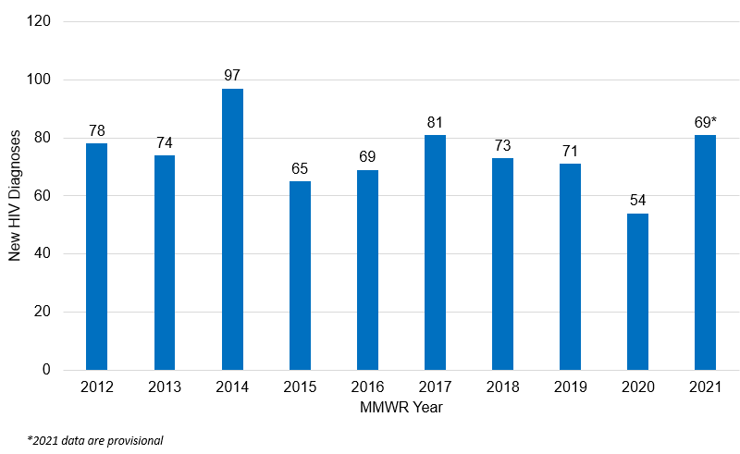
Number of New HIV Diagnoses by Year, Rhode Island, 2012-2021
Source: Rhode Island Department of Health
Rhode Island Department of Health

Slide 7
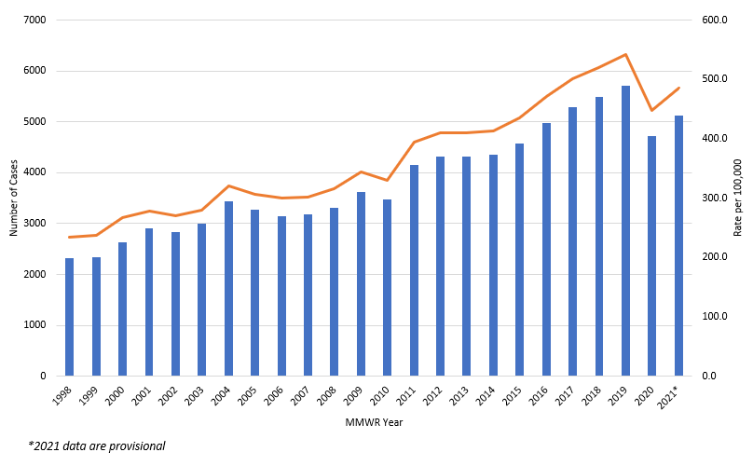
Number of Chlamydia Diagnoses, Rhode Island, 1998-2021
Source: Rhode Island Department of Health
Rhode Island Department of Health
Notes:
*2021 data are provisional
121.2% increase since 1998

Slide 8
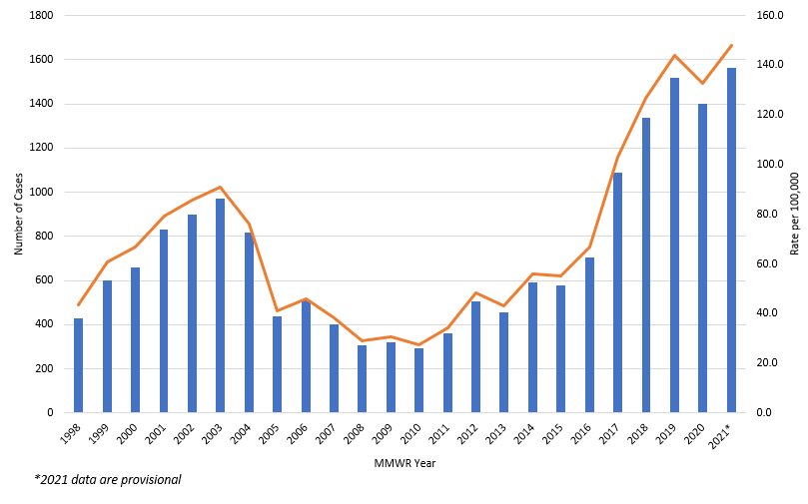
Number of Gonorrhea Diagnoses, Rhode Island, 1998-2021
Source: Rhode Island Department of Health
Rhode Island Department of Health
Notes:
*2021 data are provisional
263% increase since 1998

Slide 9
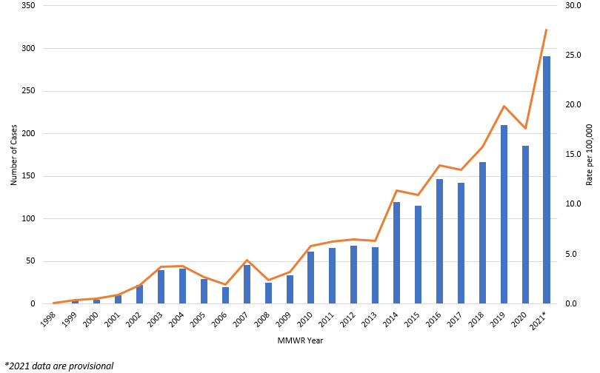
Number of Infectious Syphilis Diagnoses, Rhode Island, 1998-2021
Source: Rhode Island Department of Health
Rhode Island Department of Health
Notes:
*2021 data are provisional
CS: In 2020, RIDOH reported its first case of congenital syphilis since 2009, and before that 2004. In 2021, there was 1 case of syphilitic stillbirth reported.

Slide 10
Disparities and HIV/STIs
African-American/Black individuals have 5-8x higher rates of STIs.
Hispanic/Latino individuals have 1-2x higher rates of STIs.
Gay and bisexual men comprise almost 50% of infectious syphilis cases and have gonorrhea rates 42x that of heterosexual men.
Young people aged 15-24 years make up >60% of chlamydia cases and >40% of gonorrhea cases.
www.cdc.gov/media/releases/2021/p0413-stds.html
Rhode Island Department of Health

Slide 11
Why are STIs increasing?
Increased condomless sex (due to effective contraception and PrEP and HIV treatment);
Riskier sex associated with substance use and addiction;
Less awareness and concern about “other” STIs (compared to HIV);
Limited investment in clinical and public health infrastructure to address STIs.
Rhode Island Department of Health

Slide 12
The Public Health Impact of Sex Work
STIs are significantly increasing across Rhode Island.
Evidence demonstrates that repressive policies and criminalization of sex work leads to adverse health outcomes among sex workers, including a higher risk of HIV/STIs.
Removal of criminal and administrative sanctions for sex work can improve the health of sex workers and access to care.
We should work to improve linkage and access to healthcare and other support services for sex workers.
Rhode Island Department of Health

Slide 13
Philip A. Chan, MD
Consultant Medical Director
Rhode Island Department of Health
Philip.Chan@health.ri.gov
Contact Information

